Slide 1

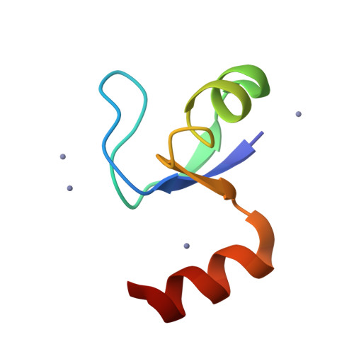
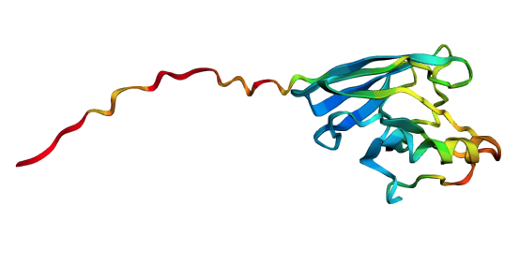
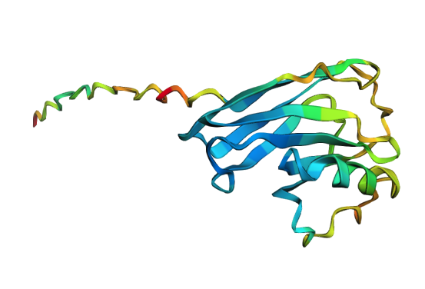
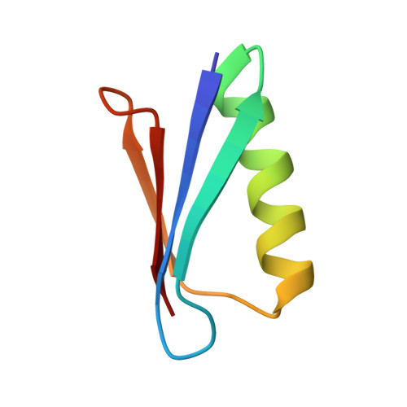
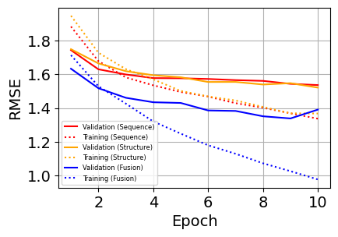
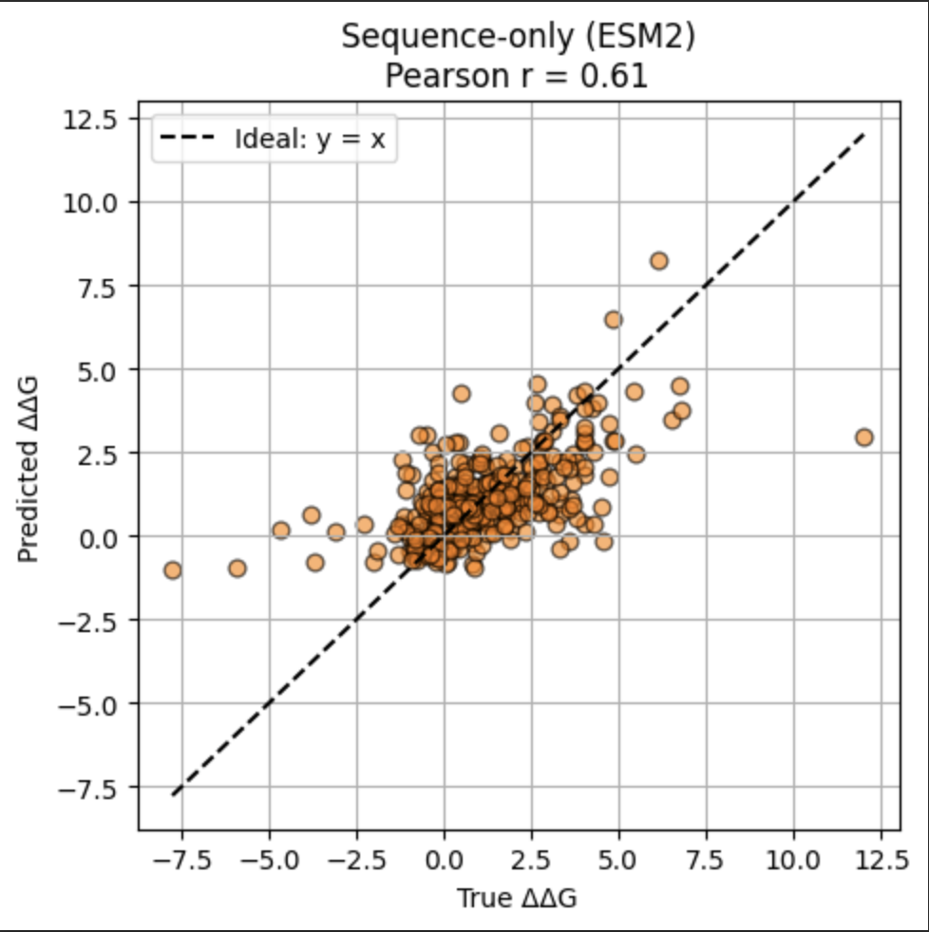
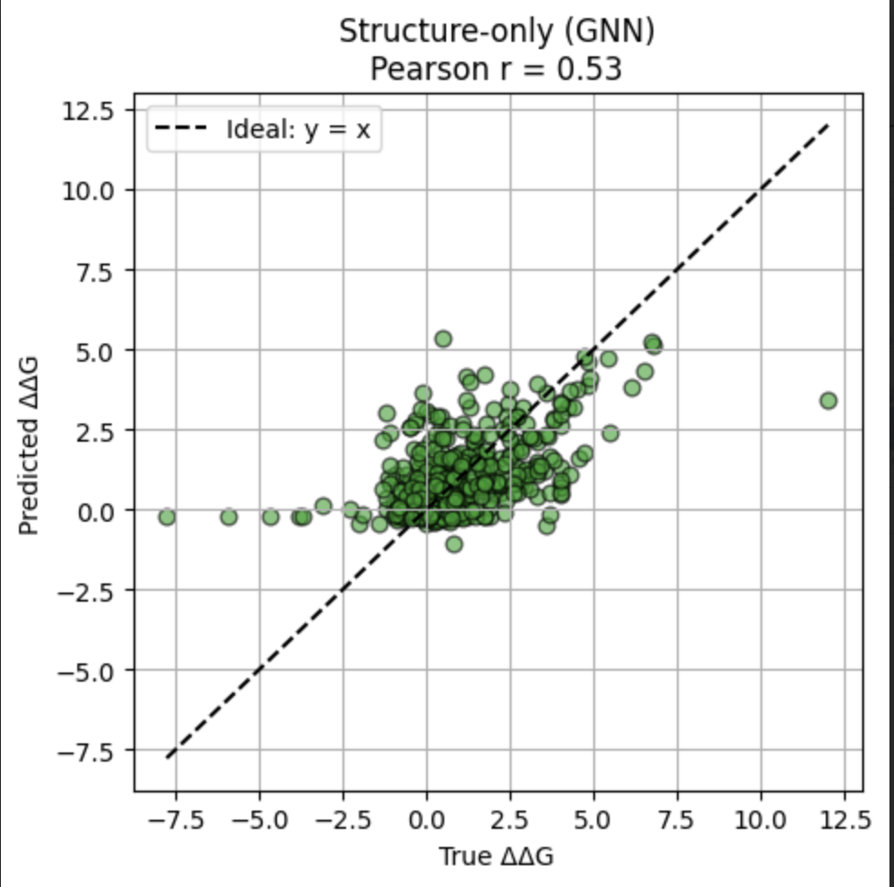
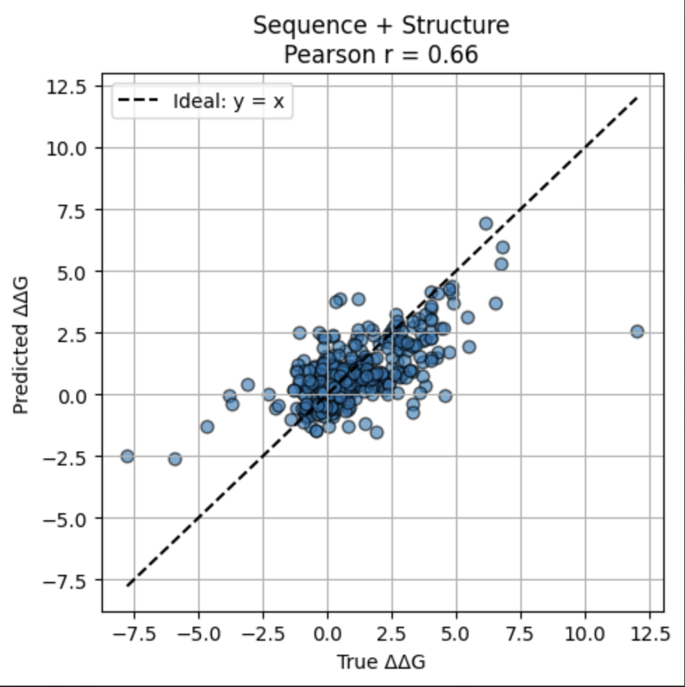
ESMGraphΔΔG: Combining Structure and Sequence to Predict the Effects of Mutations on Protein Stability
Seshu Mallina, Valentin Badea, Shyam Chandra, John Lin
Department of Biomedical Informatics, Harvard Medical School, Boston, MA 02115
{smallina, valentin_badea, shyam_chandra, john_lin}@hms.harvard.edu
Background
Methods
1
4
Single-point mutation
A
B
C
...MQFNTNAATVDKSCKQ...
Wild-type sequence
Wild-type PDB
Graphs
Wild-type sequence
Wild-type PDB
Graphs
(Azurin I40A)
...YFLRKSAFGLASVSAF...
...YFLRKSAFGLASVSAF...
✕ 3
Change in protein structure
Fixed ESM2 model
GNN
Fixed ESM2 model
GNN
Sequence embedding
Structure embedding
Sequence embedding
Structure embedding
-
Concatenated sequence + structure embedding
Linear
Element-wise
difference
Sequence embedding
Linear
ΔΔG
Transformer encoder
-
1D convolution
ΔΔG
Structure embedding
-
Linear
-
ΔΔG
Sequence embedding
Structure embedding
Sequence embedding
Structure embedding
Wild-type
Mutant
Fixed ESM2 model
GNN
Fixed ESM2 model
GNN
Change in protein stability (ΔΔG)
...YFLRKSAFGAASVSAF...
...YFLRKSAFGAASVSAF...
Mutant sequence
Mutant PDB
Graphs
Mutant sequence
Mutant PDB
Graphs
Figure 1. Schematic of how single-point mutations can affect protein stability. Predicted structures from AlphaFold2.
Figure 2. Model architecture of sequence-only (A), structure-only (B), and sequence + structure (C) models.
Node Matrix
Adjacency List
Results
Discussion
Accurate calculation of ΔΔG can facilitate the development of stable proteins.
Experimental measurement of ΔΔG is laborious and time-consuming.
Current computational methods for predicting ΔΔG do not consider both sequence and structure simultaneously.
Integrating sequence- and structure-based embeddings may provide richer representations that capture both evolutionary and structural contexts.
5
6
Model | RMSE | PCC | R²
Sequence only (ESM2) | 1.47 | 0.61 | 0.37
Structure only (GNN) | 1.59 | 0.53 | 0.28
Sequence + Structure | 1.40 | 0.66 | 0.46
Table 2. Performance of different models on the validation dataset. RMSE: Root mean square error, SCC: Spearman correlation coefficient, R²: Squared Pearson correlation coefficient
We introduce ESMGraphΔΔG, a novel deep-learning approach that integrates sequential and structural information to accurately predict the effects of single-point mutations on protein stability.
The sequence (A) model achieves the lowest error and best ranks mutations stability compared to structure (B) and combined (C) architecture. This highlights the contextual power of pretrained sequence models.
Our model can complement experimental methods and support computational protein design by rapidly screening protein variants.
Research Question
Future Work
2
Can we accurately predict changes in protein stability (ΔΔG) upon single-point mutations by combining information from protein sequence and 3D structure?
Figure 3. Performance of different models on the training and validation datasets. RMSE: Root mean square error
Refine GNN model architecture, fine-tune, and train-val-test split.
Evaluate performance for stabilizing vs destabilizing mutations.
Validate with external datasets (e.g. S669).
Extend to ΔΔG predictions from multi-point mutations.
A
Sequence Only: Predicted vs Observed ΔΔG
B
Structure Only: Predicted vs Observed ΔΔG
C
Fusion Model: Predicted vs Observed ΔΔG
References
7
Dataset
3
Stourac, J., Dubrava, J., Musil, M., Horackova, J., Damborsky, J., Mazurenko, S., & Bednar, D. (2021). FireProtDB: database of manually curated protein stability data. Nucleic acids research, 49(D1), D319–D324. https://doi.org/10.1093/nar/gkaa981
Savojardo, C., Manfredi, M., Martelli, P. L., & Casadio, R. (2024). DDGemb: predicting protein stability change upon single- and multi-point variations with embeddings and deep learning. Bioinformatics (Oxford, England), 41(1), btaf019. https://doi.org/10.1093/bioinformatics/btaf019
Lin, Z., Akin, H., Rao, R., Hie, B., Zhu, Z., Lu, W., Smetanin, N., Verkuil, R., Kabeli, O., Shmueli, Y., Dos Santos Costa, A., Fazel-Zarandi, M., Sercu, T., Candido, S., & Rives, A. (2023). Evolutionary-scale prediction of atomic-level protein structure with a language model. Science (New York, N.Y.), 379(6637), 1123–1130. https://doi.org/10.1126/science.ade2574
Jumper, J., Evans, R., Pritzel, A., Green, T., Figurnov, M., Ronneberger, O., Tunyasuvunakool, K., Bates, R., Žídek, A., Potapenko, A., Bridgland, A., Meyer, C., Kohl, S. A. A., Ballard, A. J., Cowie, A., Romera-Paredes, B., Nikolov, S., Jain, R., Adler, J., Back, T., … Hassabis, D. (2021). Highly accurate protein structure prediction with AlphaFold. Nature, 596(7873), 583–589. https://doi.org/10.1038/s41586-021-03819-2
Dataset | Proteins | Mutations | ΔΔGs
FireProtDB | 143 | 4,443 | 10,279
Table 1. Summary of filtered FireProtDB, a curated database of experimentally validated protein stability data for single-point mutants.
Figure 4. Predicted vs observed ΔΔG with Pearson and Spearman correlation coefficients of
sequence-only (A), structure-only (B), and sequence + structure (C) models.

